Slide 1

Java OOP
Course Introduction
SoftUni Team
Technical Trainers
Software University
https://softuni.bg/

Slide 2
Table of Contents
Course Objectives
Training and Team
Course Organization
Course Infrastructure
Evaluation Criteria

Slide 3
Have a Question?
sli.do
#java-fund

Slide 4

Course Objectives

Slide 5
Why OOP?
Object-oriented programming is an important paradigm
Anyone involved in software development should be familiar with OOP and OO modelling
All modern languages are either object-oriented or support classes and objects
Modern frameworks, libraries and APIs are object-oriented
OOP is a basic requirement for starting a job as developer

Slide 6
Practical Exam
2 practical problem for 6 hours:
Create a simple projects
Should correctly follow the OOP principles
You should implement functionality based on the description
Test a provided class
Automated judge system with real-time feedback
Upload a zip project to the judge system

Slide 7

The Team

Slide 8
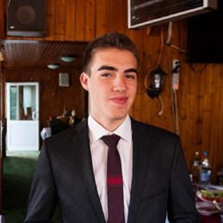
Trainers Team
Nikolai Bankin
Top performing student from the Software University (2014)
5 years of programming experience
Teacher at TUES
Expirienced with Java, Scala, JavaScript and other platforms and technologies.

Slide 9
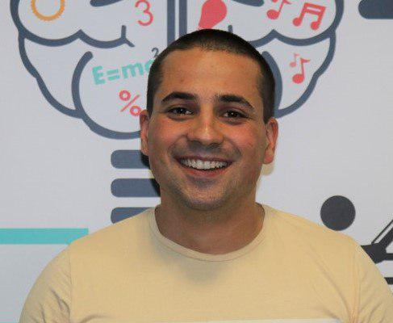
Trainers Team
Martin Paunov
Junior Automatization Programmer
Experience with Java, C++, C#
Technical Trainer @ SoftUni
Interested in Astrophysics

Slide 10

Course Organization

Slide 11
Course Information
7 weeks / 4 times a week
15 Credits
Time frame
26 February 2019 – 14 April 2019
Exam
14 April 2019 – 09:00
Retake
18 April 2019 – 09:00

Slide 12

Homework Assignments & Exercises
Your homework is mainly work in class
Lesson days → slides + live demos + exercises
Exercise days → only exercises
How to submit your homework?
Submitted in the judge system
Do your homework when it's due
Assignments pile up quickly

Slide 13


Scoring System for the Course
Mandatory:
Final exam – 85%
Exercises & homework – 15%
Bonuses:
Presence in class – 5% bonus
Forum activity – bonus up to 5%

Slide 14



Course Web Site, Forum and FB Group
Official web site:
Official discussion forum:
Official Facebook groups:
https://softuni.bg/trainings/2246/java-advanced-january-2019
https://softuni.bg/forum/categories/7/java-advanced
https://www.facebook.com/groups/JavaFundamentalsJanuary2019/

Slide 15
https://softuni.bg/csharp-oop

Slide 16
SoftUni Diamond Partners

Slide 17
SoftUni Organizational Partners

Slide 18




Trainings @ Software University (SoftUni)
Software University – High-Quality Education and Employment Opportunities
softuni.bg
Software University Foundation
http://softuni.foundation/
Software University @ Facebook
facebook.com/SoftwareUniversity
Software University Forums
forum.softuni.bg

Slide 19

License
This course (slides, examples, demos, videos, homework, etc.) is licensed under the "Creative Commons Attribution-NonCommercial-ShareAlike 4.0 International" license

